Slide 1


Distributed Messaging with Apache Kafka
Mateusz Dymiński

Slide 2
Agenda
Basic Kafka Operations
Adding and removing topics
Modifying topics
Checking consumer position
Expanding your cluster
Decommissioning brokers

Slide 3
Agenda
Other
Geo Replication
Important Server Configs
Important Client Configs
Production Server Configs
Java
Hardware and OS
Monitoring
How many topics can I have
How to choose number of partitions

Slide 4
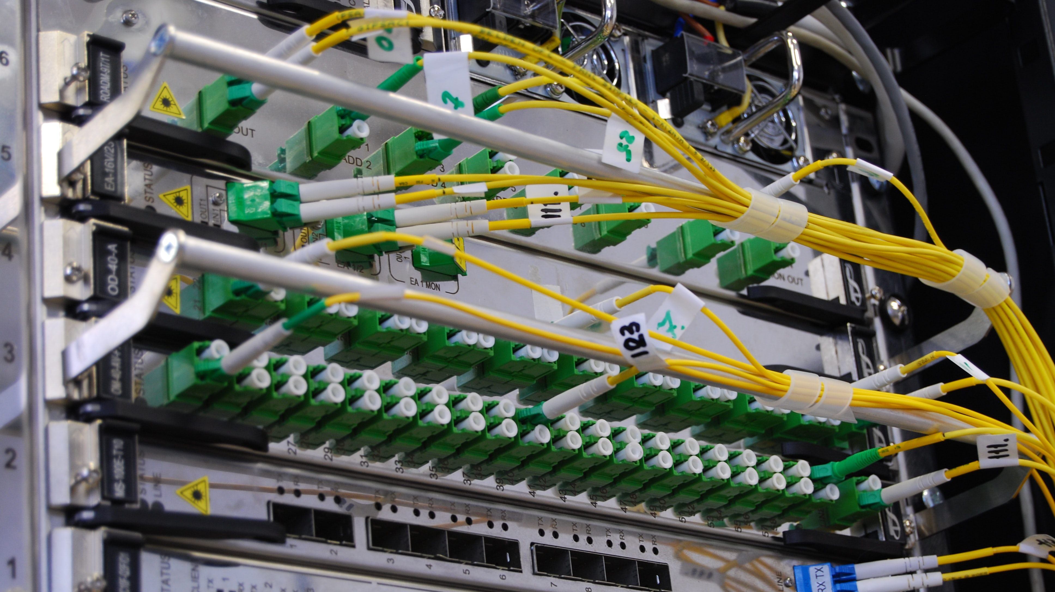
Basic Kafka Operations

Slide 5
Basic Kafka Operations
Adding and removing topics
Modifying topics
Checking consumer position
Expanding your cluster
Decommissioning brokers

Slide 6
Adding, modifying and removing topics
Topics are added and modified using the topic tool
Tool is located in KAFKA_HOME/bin

Slide 7

Exercise 11

Slide 8
Checking consumer position
Sometimes it's useful to see the position of your consumers.
We have a tool that will show the position of all consumers in a consumer group as well as how far behind the end of the log they are.

Slide 9
Managing consumer group
With the ConsumerGroupCommand tool, we can list, describe, or delete the consumer groups.
The consumer group can be deleted manually, or automatically when the last committed offset for that group expires.
Manual deletion works only if the group does not have any active members.

Slide 10
Exercise 12

Slide 11
Expanding your cluster
Adding servers to a Kafka cluster is easy, just assign them a unique broker id and start up Kafka on your new servers.
However these new servers will not automatically be assigned any data partitions, so unless partitions are moved to them they won't be doing any work until new topics are created.
So usually when you add machines to your cluster you will want to migrate some existing data to these machines.

Slide 12
Exercise 13

Slide 13
Decommissioning brokers
The partition reassignment tool does not have the ability to automatically generate a reassignment plan for decommissioning brokers yet.
As such, the admin has to come up with a reassignment plan to move the replica for all partitions hosted on the broker to be decommissioned, to the rest of the brokers.

Slide 14

Other

Slide 15
Other
Geo Replication
Important Server Configs
Important Client Configs
Production Server Configs
Java Version
Hardware and OS
Monitoring

Slide 16
Geo Replication

Slide 17
Geo Replication
Kafka administrators can define data flows that cross the boundaries of individual Kafka clusters, data centers, or geo-regions.

Slide 18
Replication and Geo-replication – why?
Geo-replication
Disaster recovery
Feeding edge clusters into a central, aggregate cluster
Physical isolation of clusters (such as production vs. testing)
Cloud migration or hybrid cloud deployments
Legal and compliance requirements

Slide 19
Mirror Maker
Replication and geo-replication is done with MirrorMaker(2)
MirrorMaker 2 (MM2) is designed to make it easier to mirror or replicate topics from one Kafka cluster to another.
It uses the Kafka Connect framework to simplify configuration and scaling.
Dynamically detects changes to topics and ensures source and target topic properties are synchronized, including offsets and partitions

Slide 20
Replication types
Active/Active high availability deployments: A->B, B->A
Active/Passive or Active/Standby high availability deployments: A->B
Aggregation (e.g., from many clusters to one): A->K, B->K, C->K
Fan-out (e.g., from one to many clusters): K->A, K->B, K->C
Forwarding: A->B, B->C, C->D

Slide 21
Broker Configuration Tuning

Slide 22
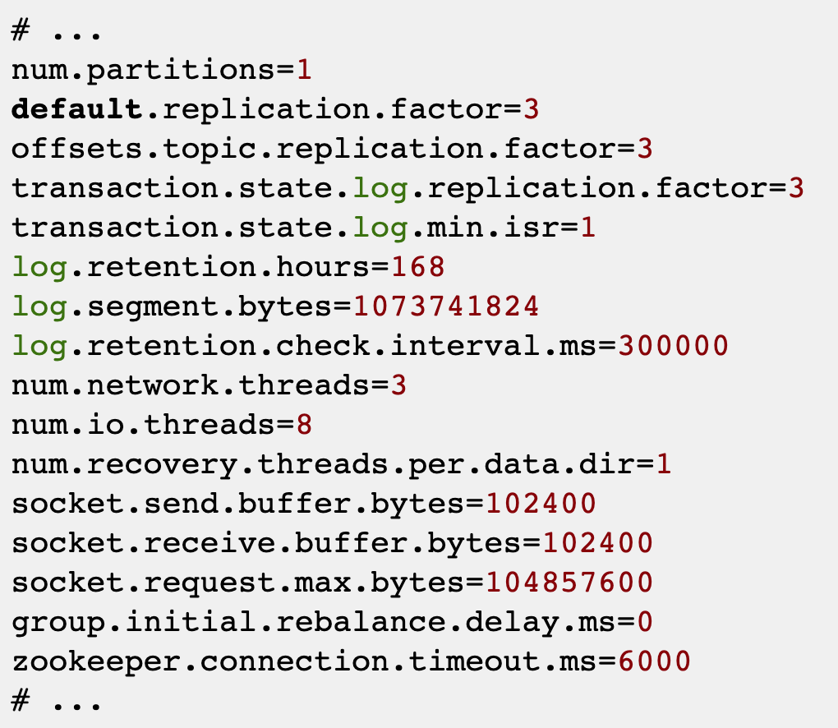
A basic broker configuration might look something like this. You’ll see settings for topics, threads and logs.

Slide 23
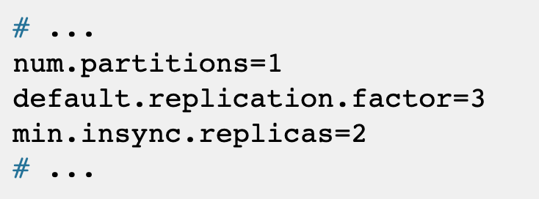
Replicating topics for high availability
When you configure topics, the number of partitions, minimum number of in-sync replicas, and partition replication factor are typically set at the topic level.
You can also set these properties at the broker level too.
In which case, the defaults are applied to topics that do not have these properties set explicitly, including automatically-created topics.

Slide 24
Replicating topics for high availability
High availability environments require a replication factor of at least 3 for topics
minimum number of in-sync replicas as 1 less than the replication factor.
For increased data durability, set min.insync.replicas in your topic configuration and message delivery acknowledgments using acks=all in your producer configuration.

Slide 25
Creating and deleting topics
The auto.create.topics.enable property is enabled by default so that topics are created when needed by a producer or consumer. It’s usually disabled in production
If you are using automatic topic creation, you can set the default number of partitions for topics using num.partitions.
Use it with the default.replication.factor property.

Slide 26
Creating and deleting topics
The delete.topic.enable property is enabled by default to allow topics to be deleted.
Kafka users normally disable this property in production too.
This time you’re making sure that data is not accidentally lost, although you can temporarily enable the property to delete topics if circumstances demand it.

Slide 27
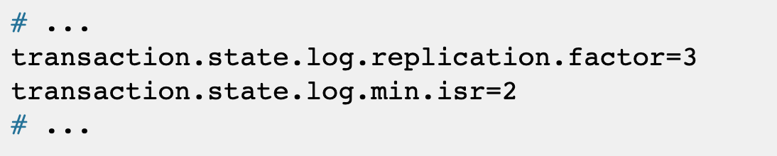
Internal topic settings for transactions and commits
Pay attention to the configuration requirements for internal Kafka topics.
If you are using transactions to enable atomic writes to partitions from producers, the internal __transaction_state topic used in the process requires a minimum of three brokers with the default settings.

Slide 28
Internal topic settings for transactions and commits
Pay attention to the configuration requirements for internal Kafka topics.
If you are using transactions to enable atomic writes to partitions from producers, the internal __transaction_state topic used in the process requires a minimum of three brokers with the default settings.

Slide 29
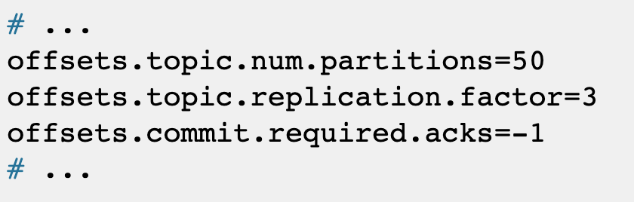
Internal topic settings for transactions and commits
The __consumer_offsets topic, which stores partition offset commits, has default settings for the number of partitions and replication factor.

Slide 30
Improving request handling throughput by increasing I/O threads
Network threads (num.network.threads) handle requests to the Kafka cluster, such as produce and fetch requests from client applications. Adjust the number of network threads to reflect the replication factor and the levels of activity from client producers and consumers interacting with the Kafka cluster.
I/O threads (num.io.threads) pick up requests from the request queue to process them. Adding more threads can improve throughput, but the number of CPU cores and disk bandwidth imposes a practical upper limit. A good starting point might be to start with the default of 8 multiplied by the number of disks.

Slide 31
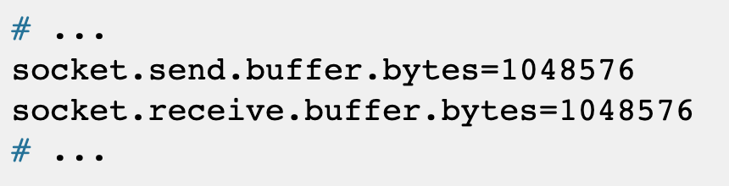
Increasing throughput for high latency connections
If you’ve fine-tuned the size of your message batches, the default values of the buffers for sending and receiving messages might be too small for the required throughput.
If you want to change the values, you can work out the optimal size of your buffers using a bandwidth-delay product calculation.
Go look at this wiki definition to see examples of the calculation.

Slide 32
Handling large message sizes
Ideally, individual messages aren’t more than a few 100KB, and are batched by the producer for better throughput up to the limit configured by message.max.bytes (broker config) or max.message.bytes (topic config). This defaults to 1MB.
You have four ways to handle large message sizes:
Producer-side message compression
Reference-based messaging
Inline messaging
Broker and producer/consumer configuration
It’s recommend trying producer-side message compression or reference-based messaging, which cover most situations.

Slide 33
Important Client Configs

Slide 34
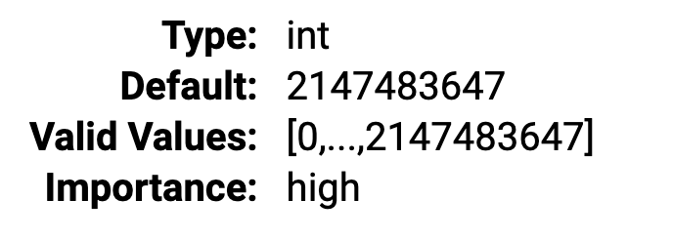
Important Producer Config
Retries: This configuration is used to set the maximum number of retry attempts to be done by the producer in case of any message publish failure.
If your application can not afford to miss any data publish, we increase this count to guarantee to publish our data.

Slide 35
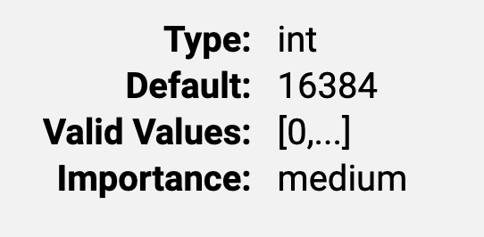
Important Producer Config
Batch size: It is set to have high throughput in our producer application by combining multiple network calls into one.
batch.size measures batch size in total bytes,
It makes sense to increase its value when your producer is publishing data all the time to have the best throughput
otherwise, it will have to wait till the given size is collected.

Slide 36
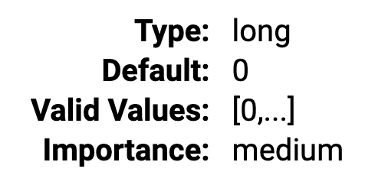
Important Producer Config
Linger time: This configuration collaborates with batch size to have high throughput.
linger.ms sets the maximum time to buffer data in asynchronous mode.
Suppose we set 300kb in batch.size and 10 ms in linger.ms, then the producer waits till at least one of them is breached.
Setting linger.ms=5, for example, would have the effect of reducing the number of requests sent but would add up to 5ms of latency to records sent in the absence of load.

Slide 37
Important Producer Config
Linger time: This configuration collaborates with batch size to have high throughput.
linger.ms sets the maximum time to buffer data in asynchronous mode.
Suppose we set 300kb in batch.size and 10 ms in linger.ms, then the producer waits till at least one of them is breached.
Setting linger.ms=5, for example, would have the effect of reducing the number of requests sent but would add up to 5ms of latency to records sent in the absence of load.

Slide 38
Important Producer Config
Acks: It is used to set the number of replicas for which the coordinator node will wait before sending a successful acknowledgment to the producer application.
There are 3 values possible for this configuration — 0,1 and -1(all).
0 means no acknowledgment is required. It is set when low latency is required.
-1 (or all) means response from all the replicas for the given partition is inevitable and it is set when data consistency is most crucial.

Slide 39
Important Producer Config
Compression - The compression type for all data generated by the producer. The default is none (i.e. no compression).
Valid values are none, gzip, snappy, lz4, or zstd.
Compression is of full batches of data, so the efficacy of batching will also impact the compression ratio (more batching means better compression).

Slide 40
Important Consumer Config
Consumer group: It plays a significant role for the consumer as you can have multiple instances of the consumer application within the same consumer group to consume messages from a Kafka topic.
The number of consumers should be less than or equal to the number of partitions in the Kafka topic as a partition can be assigned to only one consumer in a consumer group.

Slide 41
Important Consumer Config
Auto vs Manual commit: A consumer has to commit the offset after consuming a message from a topic. This commit can be made automatically or manually.
enable.auto.commit is the property which needs to be true to enable auto-commit. It is enabled by default.
auto.commit.interval.ms is the dependent property which is taken into account when auto-commit is enabled. It is used to set the max time in ms to wait to make a commit for the consumed messages.

Slide 42
Important Consumer Config
Heartbeat interval: This property is used by the consumers to send their heartbeat to the Kafka broker. It tells Kafka that the given consumer is still alive and consuming messages from it.
heartbeat.interval.ms = 10ms the consumer sends its heartbeat to the Kafka broker at every 10 milliseconds.

Slide 43
Important Consumer Config
Session timeout: It is the time when the broker decides that the consumer is died and no longer available to consume.
session.timeout.ms = 50 ms Suppose the consumer is down and it is not sending heartbeat to Kafka broker, then the broker waits until 50 ms time is over, to decide the consumer is dead.

Slide 44
Important Consumer Config
Auto offset reset strategy: It is used to define the behavior of the consumer when there is no committed offset. This would be the case when the consumer is started for the first time or when an offset is out of range.
There are 3 possible values for the property auto.offset.reset = earliest, latest, none . The default value is the latest.

Slide 45
Java

Slide 46
Java
Java 8 and Java 11 are supported.
Java 11 performs significantly better if TLS is enabled, so it is highly recommended (it also includes a number of other performance improvements: G1GC, CRC32C, Compact Strings, Thread-Local Handshakes and more).
Java 9 and 10 are not supported.

Slide 47
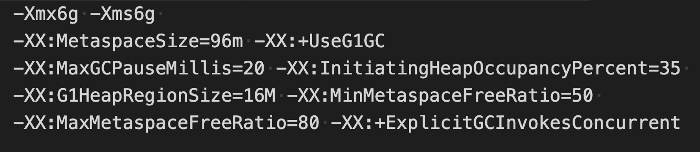
Java
Typical arguments for running Kafka with OpenJDK-based Java implementations (including Oracle JDK) are:
60 brokers
50k partitions (replication factor 2)
800k messages/sec in
300 MB/sec inbound, 1 GB/sec+ outbound

Slide 48
Java
Be sure that
-XX:+HeapDumpOnOutOfMemoryError -XX:HeapDumpPath=/PATH/
Are enabled

Slide 49
Hardware and OS

Slide 50
Disk
The disk throughput is important.
In general disk throughput is the performance bottleneck, and more disks is better.
Depending on how you configure flush behavior you may or may not benefit from more expensive disks (if you force flush often then higher RPM SAS drives may be better).

Slide 51
Disk
It’s recommend using multiple drives to get good throughput and not sharing the same drives used for Kafka data.
You can either RAID these drives together into a single volume or format and mount each drive as its own directory.
If you configure multiple data directories partitions will be assigned round-robin to data directories.
Each partition will be entirely in one of the data directories. If data is not well balanced among partitions this can lead to load imbalance between disks
RAID can potentially do better at balancing load between disks
The primary downside of RAID is that it is usually a big performance hit for write throughput and reduces the available disk space.

Slide 52
Flush management
It’s recommend using the default flush settings which disable application fsync entirely.
This means relying on the background flush done by the OS and Kafka's own background flush.
This provides the best of all worlds for most uses: no knobs to tune, great throughput and latency, and full recovery guarantees.

Slide 53
Filesystem
Kafka uses regular files on disk, and as such it has no hard dependency on a specific filesystem.
The two filesystems which have the most usage, however, are EXT4 and XFS.
Historically, EXT4 has had more usage, but recent improvements to the XFS filesystem have shown it to have better performance characteristics for Kafka's workload with no compromise in stability.

Slide 54
Memory
You need sufficient memory to buffer active readers and writers.
You can do a back-of-the-envelope estimate of memory needs by assuming you want to be able to buffer for 30 seconds and compute your memory need as write_throughput*30.
A machine with 64 GB of RAM is a decent choice, but 32 GB machines are not uncommon. Less than 32 GB tends to be counterproductive (you end up needing many, many small machines).

Slide 55
CPU
Most Kafka deployments tend to be rather light on CPU requirements.
As such, the exact processor setup matters less than the other resources.
Note that if SSL is enabled, the CPU requirements can be significantly higher
If you need to choose between faster CPUs or more cores, choose more cores.

Slide 56
OS
It is unlikely to require much OS-level tuning, but there are three potentially important OS-level configurations:
File descriptor limits - recommend at least 100000 allowed file descriptors for the broker processes as a starting point
Maximum number of memory map areas a process may have (aka vm.max_map_count
Max socket buffer size

Slide 57
Zookeeper

Slide 58
Zookeeper
Zookeeper is a top-level software developed by Apache that acts as a centralized service and is used to maintain naming and configuration data
Provide flexible and robust synchronization within distributed systems.
Zookeeper keeps track of status of the Kafka cluster nodes and it also keeps track of Kafka topics, partitions etc.

Slide 59
Why is Zookeeper necessary for Apache Kafka?
Controller election
The controller is one of the most important broking entity in a Kafka ecosystem, and it also has the responsibility to maintain the leader-follower relationship across all the partitions
Configuration Of Topics
The configuration regarding all the topics including the list of existing topics, the number of partitions for each topic, the location of all the replicas, list of configuration overrides for all topics and which node is the preferred leader, etc.
Access control lists
Access control lists or ACLs for all the topics are also maintained within Zookeeper.
Membership of the cluster
Zookeeper also maintains a list of all the brokers that are functioning at any given moment and are a part of the cluster.

Slide 60
Exercise 14

Slide 61
Monitoring

Slide 62
General rules of monitoring Kafka
Collect logs
Collect JMX metrics
Monitor clients
Monitor zookeeper
Configure Kafka to dump heap when OOM

Slide 63
Kafka Monitoring
Kafka brokers and clients report many internal metrics
JMX is the default reporter
You can add any pluggable reporter
You could use JMX Metrics forwarder to access them from Prometheus

Slide 64
Broker metrics
https://docs.confluent.io/platform/current/kafka/monitoring.html#broker-metrics

Slide 65
Producer metrics
https://docs.confluent.io/platform/current/kafka/monitoring.html#broker-metrics

Slide 66
Per topic metrics
https://docs.confluent.io/platform/current/kafka/monitoring.html#per-topic-metrics

Slide 67
Zookeeper metrics
https://docs.confluent.io/platform/current/kafka/monitoring.html#zk-metrics

Slide 68
Key Kafka Metrics to monitor
Messages in/out
Network handler idle time
Request handler idle time
Under-Replicated partitions
Leader Elections
CPU idle time
Host Network in/out
GC metrics

Slide 69
Key Kafka Metrics to monitor
Network Request Rate
The specific metric type and name, exposed via JMX:
kafka.network: type=RequestMetrics, name=RequestsPerSec

Slide 70
Key Kafka Metrics to monitor
Network Error Rate
The specific Kafka server metric type and name:
kafka.network: type=RequestMetrics, name=ErrorsPerSec

Slide 71
Key Kafka Metrics to monitor
Under-replicated Partitions
The specific metric type and name:
kafka.server: type=ReplicaManager, name=UnderReplicatedPartitions

Slide 72
Key Kafka Metrics to monitor
Offline Partition Count
The specific metric type and name:
kafka.controller: type=KafkaController, name=OfflinePartitionsCount – Number of partitions without an active leader, therefore not readable nor writeable.

Slide 73
Key Kafka Metrics to monitor
Total Broker Partitions
The specific metric type and name:
kafka.server:type=ReplicaManager,name=PartitionCount – Number of partitions on this broker.

Slide 74
Key Kafka Metrics to monitor
Log Flush Latency
The specific metric type and name:
kafka.log: type=LogFlushStats, name=LogFlushRateAndTimeMs

Slide 75
Key Kafka Metrics to monitor
Consumer Message Rate
The specific metric type and name:
kafka.consumer: type=ConsumerTopicMetrics, name=MessagesPerSec, clientId=([-.w]+) Messages consumed per second.

Slide 76
Key Kafka Metrics to monitor
Consumer Max Lag
The specific metric type and name:
kafka.consumer: type=ConsumerFetcherManager, name=MaxLag, clientId=([-.w]+) Number of messages by which the consumer lags behind the producer

Slide 77
Key Kafka Metrics to monitor
Fetcher Lag
The specific metric type and name:
kafka.server:type=FetcherLagMetrics,name=ConsumerLag,clientId=([-.w]+),topic=([-.w]+),partition=([0-9]+)

Slide 78
Client Checklist
Consumer Lag
Partition Assignment
Partition Skew
Client Logs
GC Log
Metrics
Request latencies
Commit rates
Group rebalancing
Basic tunning
Batch size
Commit rate
Application Profiling
Source: https://www.confluent.io/kafka-summit-london18/monitor-kafka-like-a-pro/

Slide 79
Client Profiling
Run your application with: -XX:+PreserveFramePointer
Start profiling
https://github.com/jvm-profiling-tools/perf-map-agent
Visualization:
https://github.com/brendangregg/FlameGraph

Slide 80
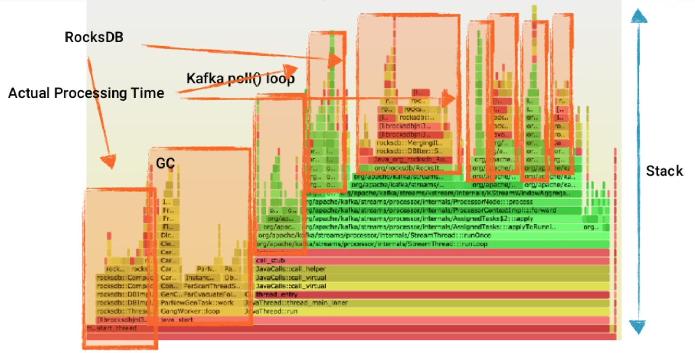
Client Profiling
Source: https://www.confluent.io/kafka-summit-london18/monitor-kafka-like-a-pro/

Slide 81
How many topics can I have?

Slide 82
How many topics can I have?
Advice: fewer large topics rather than many small topics.
For example if we were storing notifications for users we would encourage a design with a single notifications topic partitioned by user id rather than a separate topic per user.
The actual scalability is for the most part determined by the number of total partitions across all topics not the number of topics itself
But

Slide 83
How many topics can I have?
With Kafka's new KRaft mode, which entirely removes ZooKeeper from Kafka's architecture, a Kafka cluster can handle millions of topics/partitions. See https://www.confluent.io/blog/kafka-without-zookeeper-a-sneak-peek/ for details.

Slide 84
How do I choose the number of partitions for a topic?

Slide 85
How do I choose the number of partitions for a topic?
Here is a more complete list of tradeoffs to consider:
A partition is basically a directory of log files.
Each partition must fit entirely on one machine. So if you have only one partition in your topic you cannot scale your write rate or retention beyond the capability of a single machine. If you have 1000 partitions you could potentially use 1000 machines.
Each partition is totally ordered. If you want a total order over all writes you probably want to have just one partition.

Slide 86
How do I choose the number of partitions for a topic?
Each partition is not consumed by more than one consumer thread/process in each consumer group.
Many partitions can be consumed by a single process, though. So you can have 1000 partitions all consumed by a single process.
Another way to say the above is that the partition count is a bound on the maximum consumer parallelism.
More partitions will mean more files and hence can lead to smaller writes if you don't have enough memory to properly buffer the writes and coalesce them into larger writes

Slide 87
How do I choose the number of partitions for a topic?
Each partition corresponds to several znodes in zookeeper. Zookeeper keeps everything in memory so this can eventually get out of hand.
More partitions means longer leader fail-over time. Each partition can be handled quickly (milliseconds) but with thousands of partitions this can add up.
When we checkpoint the consumer position we store one offset per partition so the more partitions the more expensive the position checkpoint is.
It is possible to later expand the number of partitions BUT when we do so we do not attempt to reorganize the data in the topic.
Note that I/O and file counts are really about #partitions/#brokers, so adding brokers will fix problems there; but zookeeper handles all partitions for the whole cluster so adding machines doesn't help.

Slide 88

https://plbe.nobleprog.com/open-tef/315

Slide 89
Thanks!

